Slide 1
Quick Update

Slide 2
minfi and sesame comparison
minfi
  Less preprocessing
  EPIC v2 Manifest file needs an additional package
  379 extra Probes in the EPIC v1 Manifest file
sesame
  A lot of preprocessing if using standard pipeline
  EPIC v1 and EPIC v2 work the same

Slide 3
CNV-Analysis
Epic v1 can be analyzed in either minfi/conumee or sesame
EPIC v2 can only be analyzed in conumee 2.0 (although I only managed with loading the data directly into conumee 2.0 and not trough minfi)

Slide 4
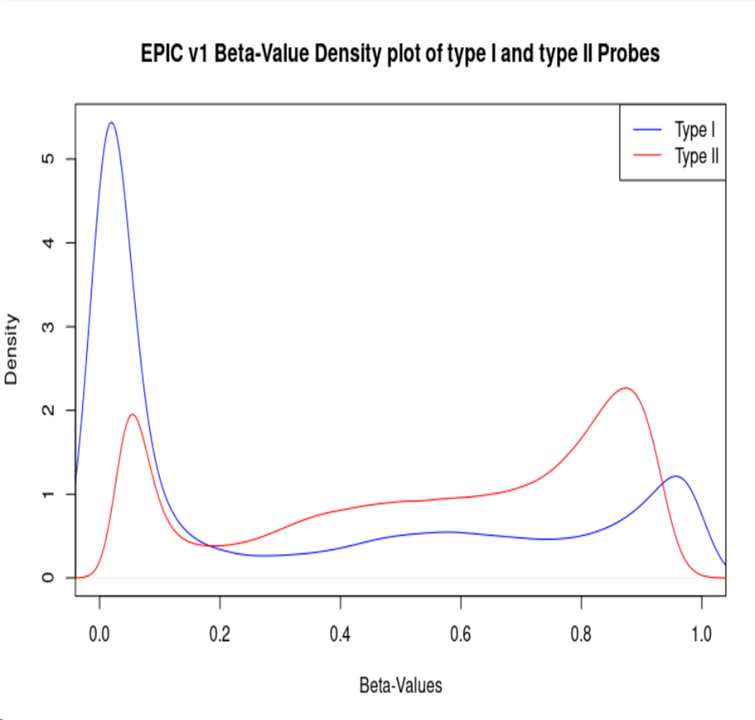
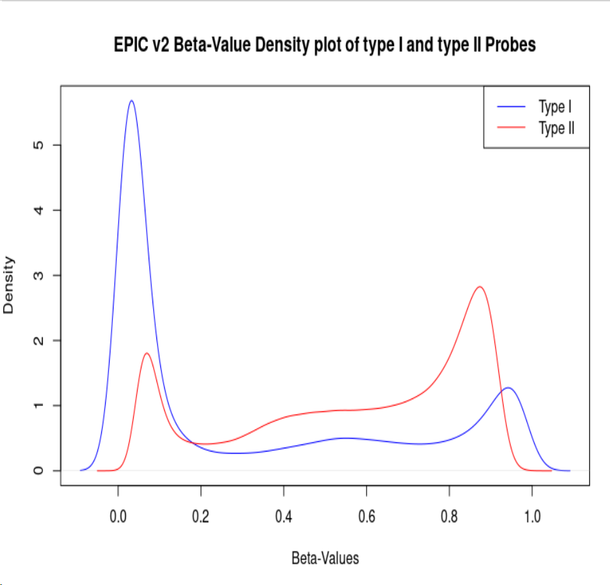
Probe Chemistry

Slide 5
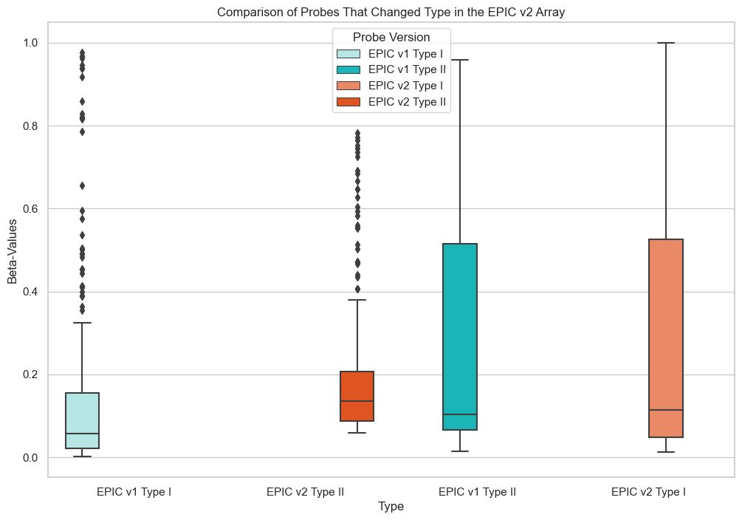
Chemistry Changes
11 Type one Probes in the EPIC v1 Array changed to Type two Probes in the
EPIC v2 Array
70 Type two probes in the EPIC v1 Aarry changed to Type one Probes in the
EPIC v2 Array

Slide 6
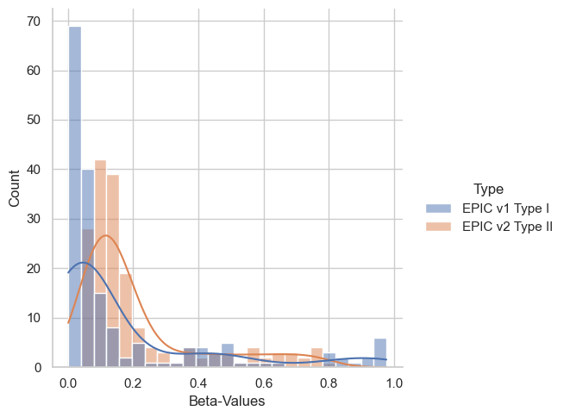
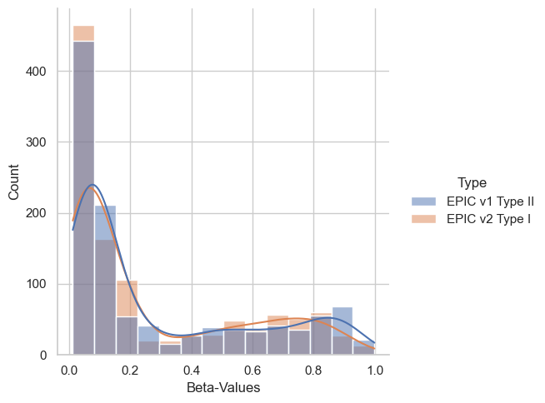
Chemistry Changes

Slide 7
